Slide 1
Clocks and Oscillators in Population Protocols [Specification and Proposed Design]
Sanchita Roy
Student Id - 201594919
Primary Supervisor - Leszek Gasieniec

Slide 2
Project Description
Population protocol models are a fairly recent development. Fundamentally, a population of miniature mobile agents that interact with one another to do a computation is characterized as population protocols. The agents are finite state machines with identical programming. The agents are first given input values, and pairs of agents can communicate When agents are close to one another, they should exchange information. The Although the agents' movement is random, there is some justice limitations, calculations, and the right result must ultimately converge any timetable that emerges from that movement will be valuable.
The population protocol model was developed to depict sensor networks made up of a small number of immobile entities that are unable to control their own motion. It is also strikingly similar to theoretical chemistry models of interacting molecules.
The uniformity and anonymity of the population protocol model are two significant features. Because the specification of a protocol is independent of the number of participating agents, it is uniform. Because the agents lack distinctive Identifier and the transition relation treats each agent equally, the system is anonymous.
In this research, I take into account a population of anonymous finite-state agents that interact with one another to update their states. A = 0, 1,..., n, 1 designates the population's set of nagents. I've just taken into account paired interactions, which involve exactly two agents updating their states in accordance with a set protocol. Identity I and identity A are simply used for notation. The agents are anonymous and cannot be separated from one another. Additionally, the same protocol is used by all agents. Any pair of agents in the population, I and j I = j), has the potential to interact.

Slide 3
Aims and Objective
Computability: When researching which functions can be computed by population protocols, one can emphasis on computing predicates.
One-way communication: Angluin et al. investigated a number of weaker interaction models in which information only travels in one direction during interactions. The status of a sender agent is revealed to a receiver agent, but the sender is unaware of the receiver's condition. A system with such one-way communication is only as powerful as the specifics of the communication mechanism.
Interaction Graphs: Physical restrictions on agents' mobility may exist in particular circumstances, which will restrict the interactions that may take place. This data is represented by an interaction graph, where nodes are agents and edges are potential interactions.
Random Interactions: The most basic version of this type assumes uniform random interactions, where each pair of agents has an equal chance of interacting at each phase. The first population protocol paper by Angluin et al. included protocols for random scheduling.
Failures: Some assumptions could be unrealistic in the context of mobile systems of small agents, an effort was made to start with a clear model. Some work has studied fault tolerant population protocol like, Crash failures, Byzantine failures

Slide 4
Overview of the results
A number of fundamental distributed computing problems, such as leader election, aggregate and threshold functions on the population, such as majority computation, and plurality consensus, can be solved within this extremely simple framework.
Let f represent a function for some natural integers a and b from [a, b] to N.
If there is a number cN such that each of the following four requirements is true, we say that f is an oscillation
1. a > c > b,
2. f (a) f (c) > f (b),
3. f (a) = f (b), and
4. f is weakly growing in [a, c] and weakly decreasing in [c, b].
The expression f(c) f(a) is known as the oscillation's amplitude and is denoted by the symbol a, whereas b an is known as the oscillation's period and is denoted by the symbol p. The oscillation's slightly growing (or dropping) phase is represented by the interval in which f is weakly decreasing.
I have offered a broad framework for programming in what I referred to as a sequential code for population protocols and outline how to compile such code into a collection of rules that are ready to be executed in the protocol environment. The language itself consists of branching instructions and finite-depth loops with predetermined lengths. Below is the screenshot of the output.

Slide 5
Time complexity and auxiliary space of Rock, Paper, Scissor
Let the lengths of the strings a and b be n and m, respectively. The games would repeat after n * m moves, which is the observation in this case. As a result, we can replicate the procedure for n * m games before counting the instances in which it is repeated. Since it would now be less than n * m, we can simulate the process once more for the remaining games. For instance, in the first illustration up top, n = 2 and m = 1. As a result, the games will repeat every n * m = 2 * 1 = 2 moves as follows: (Player2, Draw), (Player2, Draw).. (Player2, Draw).
Time Complexity: O(N * M) Auxiliary Space: O(1)

Slide 6
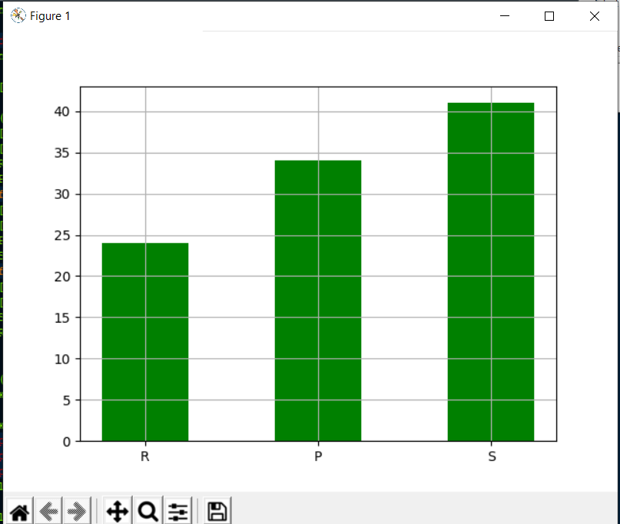
Implementation of Rock, Paper, Scissor in Python

Slide 7
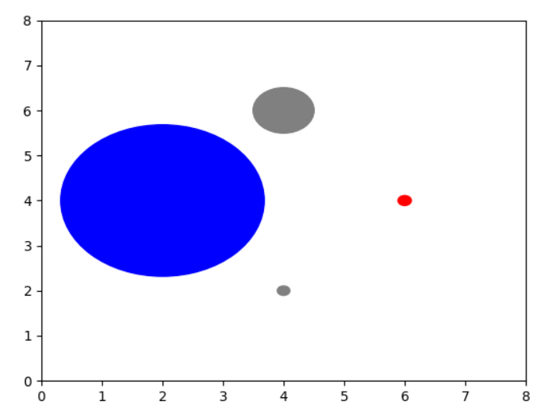
A system based on two species feeding on one another

Slide 8
References
Adrian Kosowski, Przemysław Uzna´nski: Population Protocols Are Fast
ColinCoopera, AnissaLamanib, GiovanniVigliettac, MasafumiYamashitab, YukikoYamauchib: Constructing self-stabilizing oscillators in population protocols
James Aspnes, Eric Ruppert: An Introduction to Population Protocols

